Slide 1

Hospitality Analytics
- By
Vetrivel Kumar

Slide 2
Problem Statement
Atliq Grands owns multiple five-star hotels across India. They have been in the hospitality industry for the past 20 years. Due to strategic moves from other competitors and ineffective decision-making in management, Atliq Grands are losing its market share and revenue in the luxury/business hotels category. As a strategic move, the managing director of Atliq Grands wanted to incorporate “Business and Data Intelligence” in order to regain their market share and revenue. However, they do not have an in-house data analytics team to provide them with these insights.
Their revenue management team had decided to hire a 3rd party service provider to provide them insights from their historical data.

Slide 3
Task
You are a data analyst who has been provided with sample data and a mock-up dashboard to work on the following task. You can download all relevant documents from the download section.
Create the metrics according to the metric list.
Create a dashboard according to the mock-up provided by stakeholders.
Create relevant insights that are not provided in the metric list/mock-up dashboard.

Slide 4
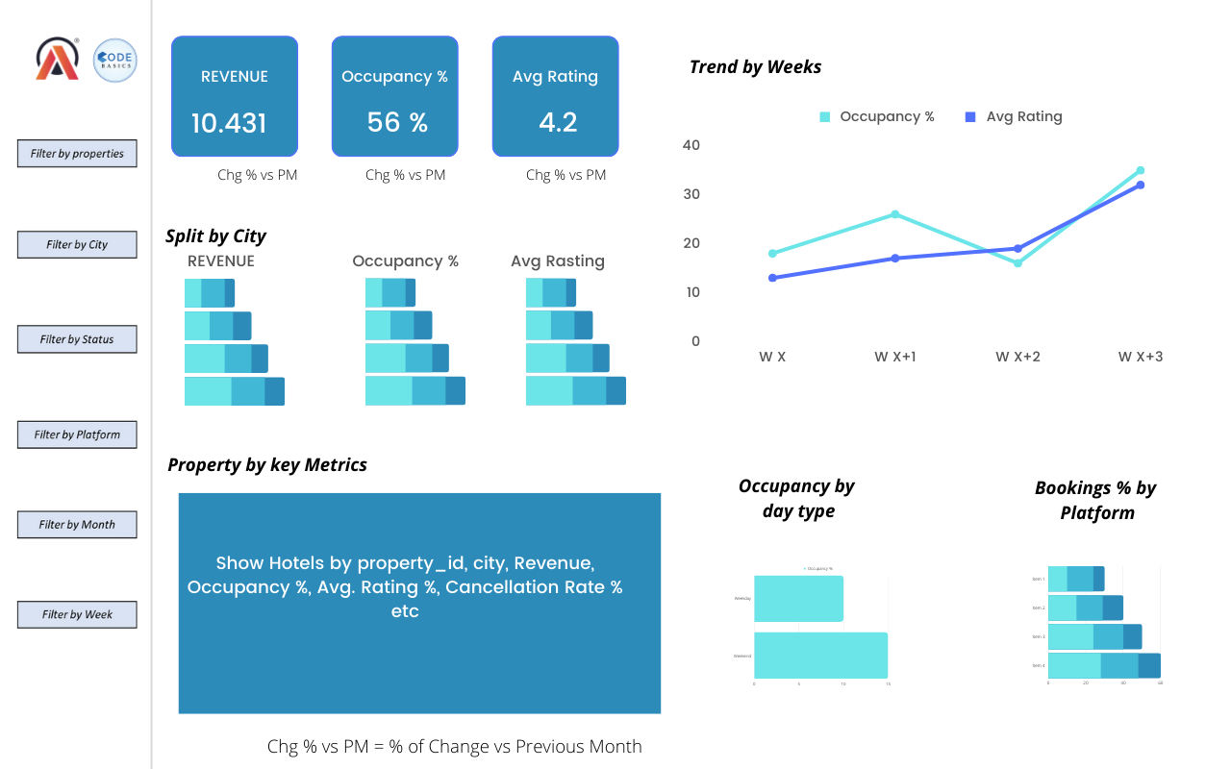

Slide 5
KPIS
Total Revenue
Occupancy %
Average Rating
ADR - Average Daily Rate
Realisation %
RevPAR – Revenue Per Available Room
DBRN – Daily Booked Room Nights
DSRN – Daily Sellable Room Nights
DURN – Daily utilized Room Nights

Slide 6
Dataset Details
We are provided 3 moths booking details data of all the atliq hotels.
Dataset contains 5 excel files.
Dim_date
Dim_hotels
Dim_rooms
Fact_aggregated_bookings
Fact_bookings
Metric list excel file
Mock-up Dashboard

Slide 7
Expected outcome after this analysis?
Regain their market share in the luxury/business hotels category.
Understanding the revenue trend by week/month/day
To get insights where business is failing and what can be done to tackle them

Slide 8
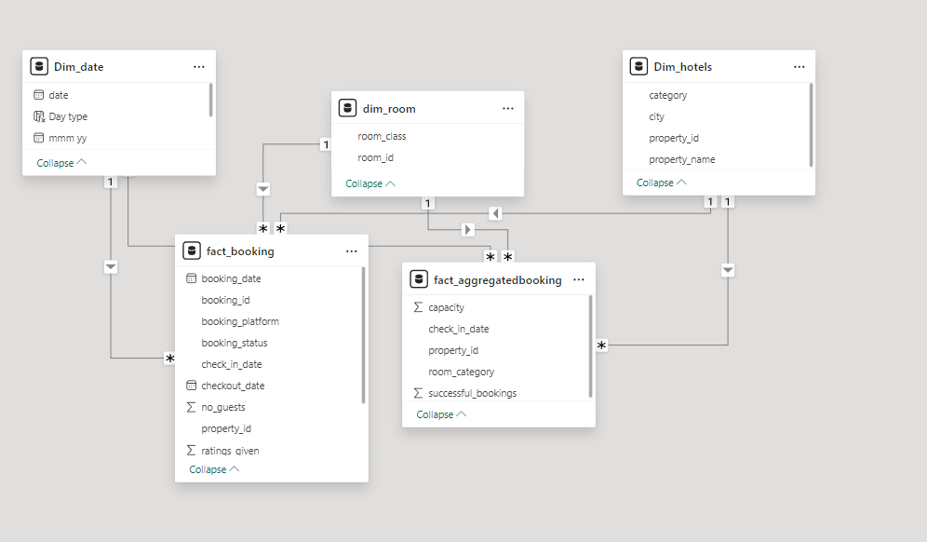
Data Model

Slide 9
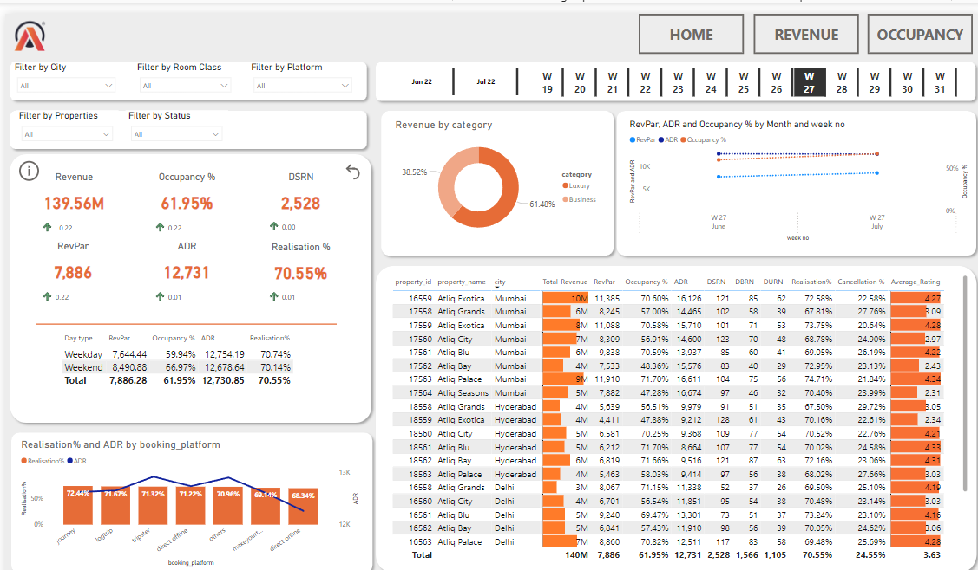

Slide 10
Insights
Mumbai generates the highest revenue (669 M) followed by Bangalore, Hyderabad and Delhi
AtliQ Exotica performs better compared to all 7 type of properties with 320 Million revenue, rating 3.62, occupancy percentage 57 and cancellation rate as 24.4%.
AtliQ Bay has the highest occupancy of 66%
Week 24 recorded the highest revenue among all, which is 139.6 Million
Delhi tops both in occupancy and rating followed by Hyderabad, Mumbai, Bangalore
AtliQ lost around 298 Million in cancellation
Elite type rooms has the most booking and as well higher cancellation rate

Slide 11
THANK YOU !!

